Slide 1

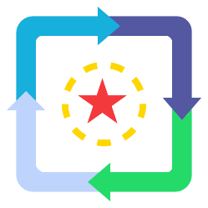
Events, Computed Properties, Watchers
Vue Instance Lifecycle
SoftUni Team
Technical Trainers
Software University
http://softuni.bg

Slide 2
Table of Contents
Event Handling
Computed Properties & Setter
Watchers
Vue Instance Lifecycle

Slide 3
Have a Question?
sli.do #vue-js

Slide 4

Event Handling
Listening, Methods, Modifiers

Slide 5
DOM Events
Working with DOM Events in Vue.js is not a complicated task
There are two ways to listen to events
Use the v-on directive
Use a shorthand @eventType
List with all DOM events https://developer.mozilla.org/en-US/docs/Web/Events

Slide 6
Listening to Events
Bind v-on and execute JS code
<div id="app">
<p>{{ counter }}</p>
<button v-on:click="counter+=1">
Add
</button>
</div>
new Vue({
el: '#app',
data: {
counter: 0
}
});

Slide 7
Method Event Handlers
The logic for the event handler might be complex
That's why v-on can also accept the name of a method
Define methods inside the Vue instance
<div id="app">
<button v-on:click="greet">
Say Hello!
</button>
</div>

Slide 8
Method Event Handlers (2)
new Vue({
methods: {
greet: function(event) {
console.log('Inside Handler');
if (event) {
alert(event.target);
}
}
}
});

Slide 9
Shorthands Vue.js 2.0
Use shorhands for cleaner event syntax binding
<div id="app">
<button @click="greet">
Say Hello!
</button>
<p @mouseover="toggle">Toggle Element</p>
</div>

Slide 10
Passing the Event
Access the targeted event with $event inside the template
<button @click
="warn('Message', $event)">
Submit
</button>
warn: function(msg, e) {
alert(e.target);
}

Slide 11
Event Modifiers
Methods should be purely about data logic
Deal with DOM event details using modifiers
// The event's propagation will be stopped
<div @click.stop="click">Click</div>
// The event will no longer reload the page
<form @submit.prevent="login"></form>
// Modifiers can be chained
<a @click.stop.prevent="click">Home</a>

Slide 12
Key Modifiers
Check for specific keyboard events
Some need to be converted to kebab-case
<input @keyup.enter="showAlert" />
<input @keyup.page-down="onPageDown" />

Slide 13

Computed Properties
Computed Caching, Setters

Slide 14

Definition
Templated should NOT perform complex logic
A computed property hosts some small computations
They are limited to a single JS expression
<div id="app">
{{ message.split('').reverse().join('') }}
</div>

Slide 15
Computed Property Example
Defined inside the computed property in the Vue instance
new Vue({
computed: {
reversedMessage: function() {
return this.message.split('').reverse().join('');
}
}
});

Slide 16

Computed Property Example
Remember that in the end this is a property
The provided function is used as a getter
<div id="app">
{{ reversedMessage() }}
</div>
<div id="app">
{{ reversedMessage }}
</div>

Slide 17
Computed Properties vs Methods
Computed Properties
A getter function
Cached based on their reactive dependencies
Re-evaluates when data changed
Methods
A normal function
Not cached
Always called in the template

Slide 18
Computed Setter
Provide a setter if needed
computed: {
fullName: {
// getter
get: function () {
return this.firstName + ' ' + this.lastName;
}, // Continued in next slide
}
}

Slide 19
Computed Setter
// setter
set: function (newValue) {
var names = newValue.split(' ');
this.firstName = names[0];
this.lastName = names[names.length - 1];
}
Can be used for validation
this.fullName = 'Mark Smith';

Slide 20

Watchers
Listening for Changes

Slide 21
Definition
Vue provides the watch option
Listen to component data
Run whenever a particular property changes
Useful for performing asynchronous or expensive operations
Similar to $watch function from AngularJS

Slide 22
Watchers Example
Defined inside the watch property in the Vue instance
<div id="app">
<p>
{{ message }}
</p>
<button @click="message='Changed'">
Change
</button>
</div>
Activated when message changes

Slide 23
Watchers Example
The watcher name should equal the name of the data property
watch: {
message: function(newValue, oldValue) {
console.log(newValue); // Changed
console.log(oldValue);
}
}

Slide 24
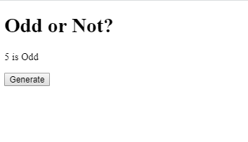
Problem: Odd or Not?
Write an application that displays if a number is odd or not
The button generates a random integer from [1..20]
Try to use a watcher

Slide 25
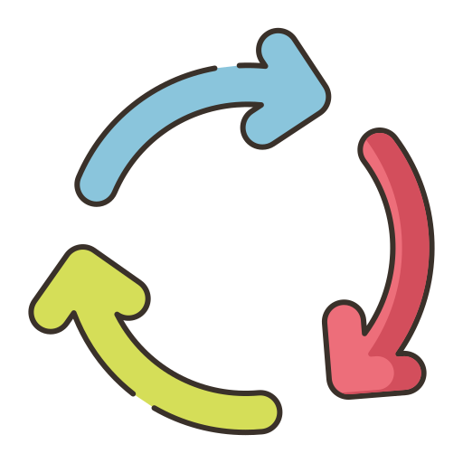
Vue Instance Lifecycle
Lifecycle Hooks

Slide 26
The Vue Instance Lifecycle
Each Vue Instance goes through a series of initialization steps
Creation, Update, Delete
It runs functions called lifecycle hooks to add code at specific stages
beforeCreate(), created(), mounted(), etc.

Slide 27
Lifecycle Diagram
new Vue()
Destroyed
before Create()
Initialize Data
before Destroy()
updated()
Re-render DOM
Instance Created
Compile Template
before Update()
created()
before Mount()
Mounted to DOM
Data Changed

Slide 28
Live Demo
Lifecycle Hooks

Slide 29

Summary
…
…
…
Listening to DOM events with v-on
Event Handlers are methods
Computed properties hold single JS expressions
Watchers listen to data changes
Each Vue Instance goes through a series of initialization steps called lifecycle

Slide 30
https://softuni.bg/trainings/2430/vuejs-fundamentals-july-2019

Slide 31












SoftUni Diamond Partners

Slide 32




SoftUni Organizational Partners

Slide 33





Trainings @ Software University (SoftUni)
Software University – High-Quality Education, Profession and Job for Software Developers
softuni.bg
Software University Foundation
http://softuni.foundation/
Software University @ Facebook
facebook.com/SoftwareUniversity
Software University Forums
forum.softuni.bg

